Slide 1


Codename Cassandra:
Backend
A modular approach for using
Wiki* GLAM’s data

Slide 2
Good architectures for
future proven applications
Like in house building, foundations are important: they are invisible but enable all the features

Slide 3
A modular data driven architecture
To afford all the needs of tomorrow a step at a time, a modular architecture, with data as protagonist.
Styles change over time, interfaces may become obsolete and when software age, tends to not work anymore!
Having data only drowned in visualizations makes difficult changes and new features.

Slide 4
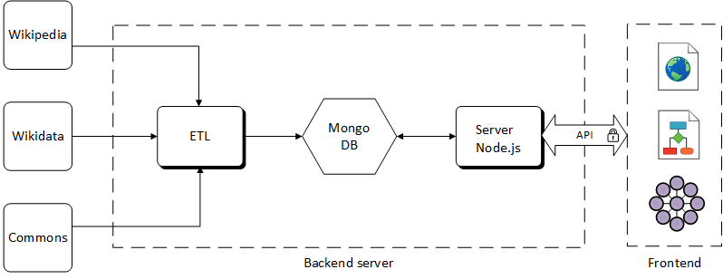

Slide 5
Backend architecture
GET
An ETL service extract data from Wiki*, parsing and loading them to the database
STORE
A MongoDB instance store all the data collected
SERVE
A node.js server exposes REST API to interact with the database

Slide 6
Make it modular!
GET
Data are taken via SQL queries or API: it’s simple to change an existing rule or to add a new one
If data format change we also change with little effort
STORE
We choose MongoDB because is a noSQL database (so is schemaless)
Old schemas and decisions aren’t blocking anymore
SERVE
Data are served via HTTP REST API: it’s easier for who write applications, it’s fast to adapt to new data
Infinite frontends are possible with zero changes here

Slide 7
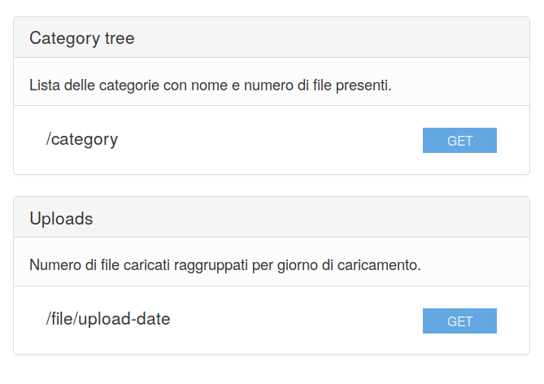
API
Modularity: it’s easy to add new ones and change the existing
Security: authentication and encrypted connection
Applications: you can build any kind of service (websites, dashboards, reports, visualizations) or integrate with existing ones

Slide 8
Which data Wiki*world provide?
Let’s have a look on
what are the data that flow here...

Slide 9
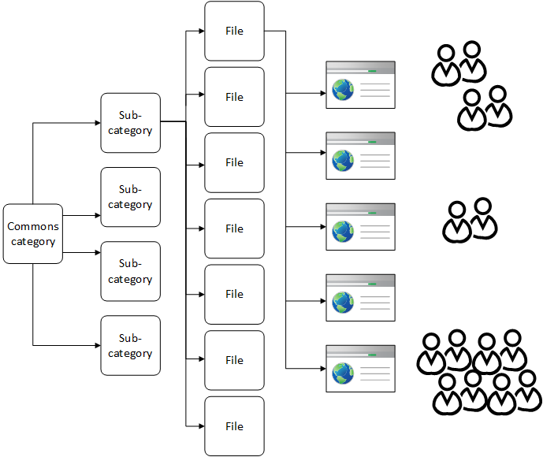

Slide 10
3 collections of data
CATEGORY
category name
category parent
category level
n° files inside
FILE
file name
upload username
upload date
file size
category
USAGE
file name
wiki project
page url
visits

Slide 11
Conclusions
So what are the abilities of this architecture
with that data?

Slide 12
Answer to (simple) questions
Which is the file most used?
Which wiki project use the higher number of files from this category?
Which is the Wikipedia single page with the highest number of files?

Slide 13
Try to answer to hard questions
Why those are the most used file?
Why many high quality files are not used?
Which is the Wikipedia field I have improved with this group of files?

Slide 14
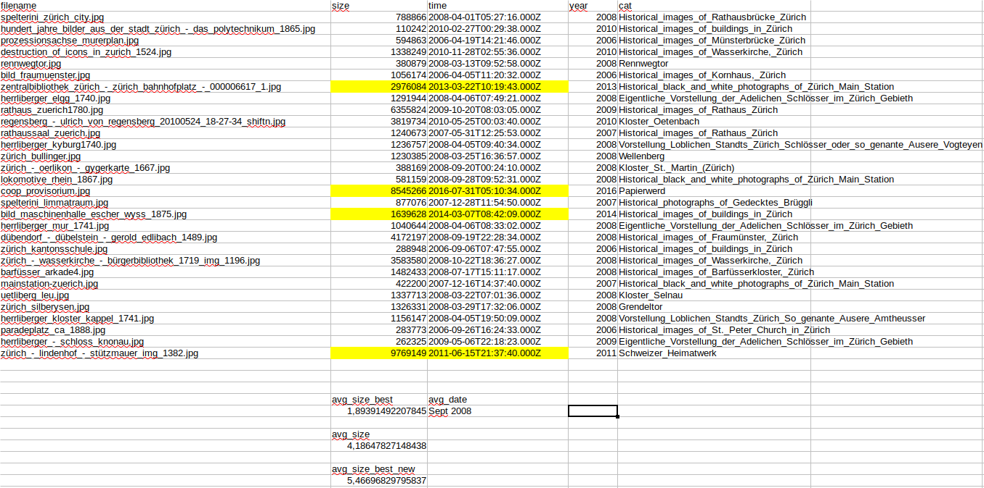

Slide 15

Keep in touch!
Made in
https://synapta.it
@synapta
CC-BY
alessio.melandri@synapta.it
@AlessioMelandri

